Slide 1
SECURITY in Node

Slide 2
SECURITY
To work with encrypted traffic on development machines, generate some test certificates. —privkey.pem and newcert.pem—the private key and certificate.
Visit this site and download binaries (zip file)
http://gnuwin32.sourceforge.net/packages/openssl.htm
Goto bin folder of openss.-0.9.8h-1-bin/bin>
Type following commands:
>openssl genrsa -out privkey.pem 1024
>openssl req -new -key privkey.pem -out certreq.csr
>openssl x509 -req -days 3650 -in certreq.csr -signkey privkey.pem -out newcert.pem

Slide 3
SECURITY
var express = require('express'),
https = require('https'),
fs = require('fs');
// 1. Load certificates and create options
var privateKey = fs.readFileSync('privkey.pem').toString();
var certificate = fs.readFileSync('newcert.pem').toString();
var options = {
key : privateKey,
cert : certificate
}

Slide 4
SECURITY
// 2. Create express app and set up routing, etc.
var app = express();
app.get("*", function (req, res) {
res.end("Thanks for calling securely!\n");
});
// 3. start https server with options and express app.
https.createServer(options, app)
.listen(8443, function (){
console.log("Express server listening on port 8443");
});
view these encrypted pages in a web browser by entering https://localhost:8443 in the address bar

Slide 5
SECURITY
http-proxy security:
var fs = require('fs'),
http = require('http'),
https = require('https'),
httpProxy = require('http-proxy');
// 1. Get certificates ready.
var options = {
https: {
key: fs.readFileSync('privkey.pem', 'utf8'),
cert: fs.readFileSync('newcert.pem', 'utf8')
}
};

Slide 6
SECURITY
// 2. Create an instance of HttpProxy to use with another server
var proxy = new httpProxy.HttpProxy({
target: {
host: 'localhost',
port: 8081
}
});
// 3. Create https server and start accepting connections.
https.createServer(options.https, function (req, res) {
proxy.proxyRequest(req, res)
}).listen(8443);

Slide 7
SECURITY
Node.js handles security and cryptography within its core (crypto) and through third-party implementations (bcrypt.js)
- Various types of hashing algorithms are available in Node.js
Supports cryptography at core level
Supports digital certificates with https protocol
Supports Transport Layer Security (TLS) module to secure servers.

Slide 8
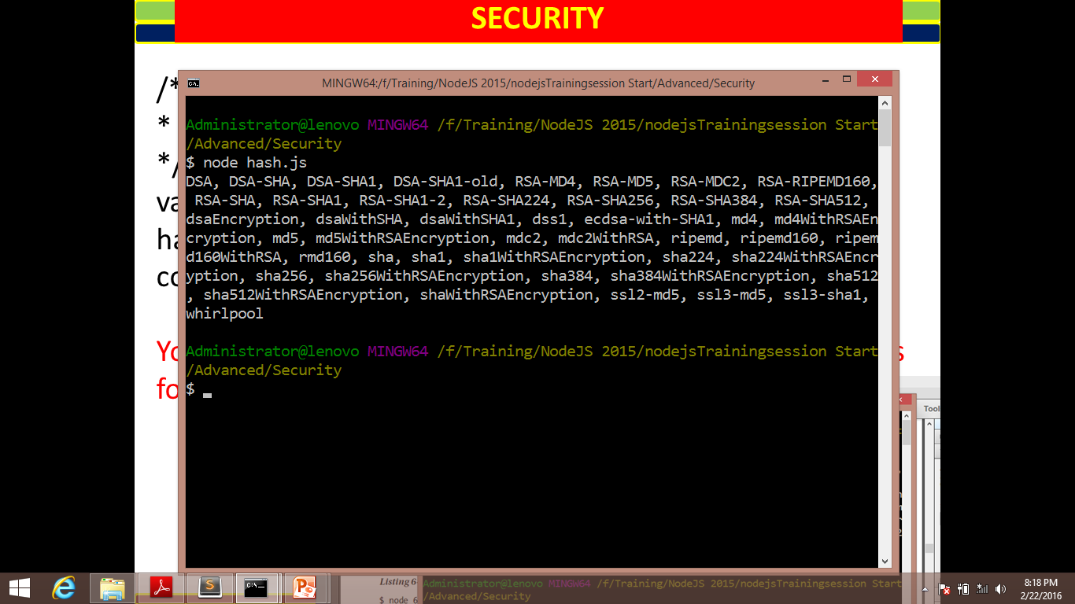
SECURITY
/**
* Hashes
*/
var crypto = require('crypto'),
hashes = crypto.getHashes();
console.log(hashes.join(', '));
You now run this code to get the full list of available hashes for Node.js.
Digital Signature Algorithm
(DSA), Message Digest (MD4, MD5, etc.), Secure Hash Algorithm (SHA), and WHIRLPOOL hash functions

Slide 9
SECURITY
Hashing Data with createHash
To implement a hash in order to secure a message.
Demo shows an example of the SHA-1 and MD5 hashing algorithms with their different encodings.
Demo : security/Createhash.js
:security/digest.js

Slide 10
SECURITY
Verifying File Integrity with Hashes
Utilize a cryptographic hash algorithm to validate the integrity of files.
check whether the content of your file or files that you access in Node.js application has changed from a previous version.
Do this with the Node.js crypto module by
generating a hash of the file’s content.
Demo : security/hashfile.js

Slide 11
SECURITY
Reviewing OpenSSL Ciphers and Security
Node.js provides a wrapper for the OpenSSL ciphers.
Ciphers are a way to encrypt and decrypt data by using a set algorithm. (Demo : security/encrypt.js)
To view these available ciphers:
/**
* Reviewing ciphers
*/
var crypto = require('crypto');
var ciphers = crypto.getCiphers();
console.log(ciphers.join(', '));

Slide 12
SECURITY
Reviewing OpenSSL Ciphers and Security
Node.js provides a wrapper for the OpenSSL ciphers.
. To view these available ciphers:
[ 'CAST-cbc', 'aes-128-cbc', 'aes-128-cbc-hmac-sha1', 'aes-128-cfb', 'aes-128-cfb1', 'aes-128-cfb8',
'aes-128-ctr', 'aes-128-ecb', 'aes-128-gcm', 'aes-128-ofb', 'aes-128-xts', 'aes-192-cbc', 'aes-192-cfb',
'aes-192-cfb1', 'aes-192-cfb8', 'aes-192-ctr', 'aes-192-ecb', 'aes-192-gcm', 'aes-192-ofb', 'aes-256-
cbc', 'aes-256-cbc-hmac-sha1', 'aes-256-cfb', 'aes-256-cfb1', 'aes-256-cfb8', 'aes-256-ctr', 'aes-256-
ecb', 'aes-256-gcm', 'aes-256-ofb', 'aes-256-xts', 'aes128', 'aes192', 'aes256', 'bf', 'bf-cbc', 'bfcfb',
'bf-ecb', 'bf-ofb', 'blowfish', 'camellia-128-cbc', 'camellia-128-cfb', 'camellia-128-cfb1',
'camellia-128-cfb8', 'camellia-128-ecb', 'camellia-128-ofb', 'camellia-192-cbc', 'camellia-192-cfb',
'camellia-192-cfb1', 'camellia-192-cfb8', 'camellia-192-ecb', 'camellia-192-ofb', 'camellia-256-cbc',
'camellia-256-cfb', 'camellia-256-cfb1', 'camellia-256-cfb8', 'camellia-256-ecb', 'camellia-256-ofb',
'camellia128', 'camellia192', 'camellia256', 'cast', 'cast-cbc', 'cast5-cbc', 'cast5-cfb', 'cast5-ecb',
'cast5-ofb', 'des', 'des-cbc', 'des-cfb', 'des-cfb1', 'des-cfb8', 'des-ecb', 'des-ede', 'des-ede-cbc',
'des-ede-cfb', 'des-ede-ofb', 'des-ede3', 'des-ede3-cbc', 'des-ede3-cfb', 'des-ede3-cfb1', 'des-ede3-
cfb8', 'des-ede3-ofb', 'des-ofb', 'des3', 'desx', 'desx-cbc', 'id-aes128-GCM', 'id-aes192-GCM', 'idaes256-
GCM', 'idea', 'idea-cbc', 'idea-cfb', 'idea-ecb', 'idea-ofb', 'rc2', 'rc2-40-cbc', 'rc2-64-cbc',
'rc2-cbc', 'rc2-cfb', 'rc2-ecb', 'rc2-ofb', 'rc4', 'rc4-40', 'rc4-hmac-md5', 'seed', 'seed-cbc', 'seedcfb',
'seed-ecb', 'seed-ofb' ]

Slide 13
SECURITY
Using Node.js’s TLS Module for Securing Your Server
Node.js server that is transmitting information must be secured. U tilizing Node.js’s TLS module.
TLS is a way to encrypt data that are sent to and from a server:
Generating OpenSSL Keys
$ openssl genrsa -out srv-key.pem 1024
$ openssl req -new –key srv-key.pem -out src-crt-request.csr
$ openssl x509 -req -in srv-crt-request.csr -signkey srv-key.pem -out srv-cert.pem
Demo : security/tlsclient.js
security/tlsserver.js

